Slide 1
PBHS 31001: Epidemiologic Methods 2024
Stata Session 5
(Slides are adopted from previous TA’s)

Slide 2
Poisson Regression

Slide 3
When to use Poisson Regression
Rate data (such as incidence rate): count of events occurring during a specified period of time for a cohort/specific region of space/distance…

Slide 4
Why we use Poisson Regression
Why can’t we just use count variables as continuous variable?
Count distribution is too skewed to satisfy normality
Normal models does not necessarily prevent negative estimated counts
Why can’t dichotomize count into 0 vs. 1 and use logistic regression?
Loss of information resulting in under-powered tests
1 event = 100 events?

Slide 5
Review measures of incidence
Cumulative incidence:
# of person of first event during time period / # persons at risk same time period (%)
Incidence (density) rate:
# of new cases of diseases / # of person-time observed
Incidence rate ratio:
incidence rate in exposure group / incidence rate in unexposed group

Slide 6
Analysis of cohort studies with the Poisson regression model
Poisson regression models the log incidence rate by group of subjects, with each group defined by a set of covariates
The groups are then compared by the incidence rate ratio
Key assumption:
the incidence rate is constant over time for each group
Assume occurrence of events follows a Poisson distribution, in which mean = variance

Slide 7
CANCER IN NICKEL WORKERS - THE SOUTH WALES COHORT
Men employed in a nickel refinery in South Wales were investigated to determine whether the risk of developing carcinoma of the bronchi and nasal sinuses, which had been associated with the refining of nickel, are still present.
The cohort was identified using the weekly paysheets of the company, on which all men receiving an hourly wage were listed by name and works' reference number. Initially, paysheets were inspected for the first week in April of the years (1929), 1934, 1939, 1944 and 1949, and all men were included whose names and numbers were recorded on any two of the sheets, unless they were noted on one of the two sheets as having been in the Armed Forces or transferred elsewhere for war work. By this means, the population was limited to men who were likely to have been employed for at least five years, and follow-up was facilitated.
Copies of the death certificates were obtained for all who were known to have died, and the cause of death was classified according to the Seventh Revision of the International Classification of Diseases (World Health Organization, 1957).

Slide 10
Descriptive analysis (grouped data)
. use "U:\Teaching\EpiMethod2_2021\Lecture13\Nickel_grouped.dta", clear
. des
Contains data from U:\Teaching\EpiMethod2_2021\Lecture13\Nickel_grouped.dta
obs: 242
vars: 12 3 Mar 2013 17:11
---------------------------------------------------------------------------------- storage display value
variable name type format label variable label
----------------------------------------------------------------------------------
AFE float %9.0g AFE age first employed
YFE float %13.0g YFE year first employed
EXP float %9.0g EXP exposure category
TFE float %9.0g TFE time since first employed
N_person float %9.0g Total persons
LungCa float %9.0g Lung cancer deaths
NasalCa float %9.0g Nasal cancer deaths
Deaths float %9.0g Total deaths
PY float %9.0g Person years
eLungCa float %9.0g Expected lung cancer deaths per 1000
eNasalCa float %9.0g Expected nasal cancer deaths per 1000
eDeaths float %9.0g Expected deaths per 1000
----------------------------------------------------------------------------------

Slide 11
Descriptive analysis (grouped data)
. list AFE YFE EXP TFE N_person LungCa NasalCa PY in 30/39
+----------------------------------------------------------------------------------------+
| AFE YFE EXP TFE N_person LungCa NasalCa PY |
|----------------------------------------------------------------------------------------|
30. | < 20.0 1910.0-1914.9 4.5-8.0 50.0+ 2 1 0 14.89441 |
31. | < 20.0 1910.0-1914.9 8.5-12.0 0.0-19.9 1 0 0 .035645 |
32. | < 20.0 1910.0-1914.9 8.5-12.0 20.0-29.9 1 0 0 10 |
33. | < 20.0 1910.0-1914.9 8.5-12.0 30.0-39.9 1 0 0 10 |
34. | < 20.0 1910.0-1914.9 8.5-12.0 40.0-49.9 1 0 0 2.769897 |
|----------------------------------------------------------------------------------------|
35. | < 20.0 1915.0-1919.9 0.0 0.0-19.9 17 0 0 50.15186 |
36. | < 20.0 1915.0-1919.9 0.0 20.0-29.9 20 0 0 181.0278 |
37. | < 20.0 1915.0-1919.9 0.0 30.0-39.9 21 1 0 190.5669 |
38. | < 20.0 1915.0-1919.9 0.0 40.0-49.9 17 1 0 146.863 |
39. | < 20.0 1915.0-1919.9 0.0 50.0+ 11 0 0 107.9049 |
+----------------------------------------------------------------------------------------+

Slide 12
Descriptive analysis (grouped data)
. label list
AFE:
1 < 20.0
2 20.0-27.5
3 27.5-35.0
4 35.0-85.0
YFE:
1 <1910.0
2 1910.0-1914.9
3 1915.0-1919.9
4 1920.0-1924.9
EXP:
1 0.0
2 0.5-4.0
3 4.5-8.0
4 8.5-12.0
5 12.5+
TFE:
1 0.0-19.9
2 20.0-29.9
3 30.0-39.9
4 40.0-49.9
5 50.0+

Slide 13
Descriptive analysis (grouped data)
. tab1 AFE YFE EXP TFE [freq=N_person]
-> tabulation of AFE
age first |
employed | Freq. Percent Cum.
------------+-----------------------------------
< 20.0 | 378 18.16 18.16
20.0-27.5 | 950 45.63 63.78
27.5-35.0 | 532 25.55 89.34
35.0-85.0 | 222 10.66 100.00
------------+-----------------------------------
Total | 2,082 100.00
-> tabulation of YFE
year first |
employed | Freq. Percent Cum.
--------------+-----------------------------------
<1910.0 | 330 15.85 15.85
1910.0-1914.9 | 429 20.61 36.46
1915.0-1919.9 | 338 16.23 52.69
1920.0-1924.9 | 985 47.31 100.00
--------------+-----------------------------------
Total | 2,082 100.00
-> tabulation of EXP
exposure |
category | Freq. Percent Cum.
------------+-----------------------------------
0.0 | 992 47.65 47.65
0.5-4.0 | 668 32.08 79.73
4.5-8.0 | 272 13.06 92.80
8.5-12.0 | 102 4.90 97.69
12.5+ | 48 2.31 100.00
------------+-----------------------------------
Total | 2,082 100.00
-> tabulation of TFE
time since |
first |
employed | Freq. Percent Cum.
------------+-----------------------------------
0.0-19.9 | 409 19.64 19.64
20.0-29.9 | 631 30.31 49.95
30.0-39.9 | 534 25.65 75.60
40.0-49.9 | 339 16.28 91.88
50.0+ | 169 8.12 100.00
------------+-----------------------------------
Total | 2,082 100.00
. tabstat LungCa NasalCa Deaths PY, s(n min max sum)
stats | LungCa NasalCa Deaths PY
---------+----------------------------------------
N | 242 242 242 242
min | 0 0 0 .035645
max | 8 2 21 677.4666
sum | 137 56 603 15230.78
--------------------------------------------------

Slide 14
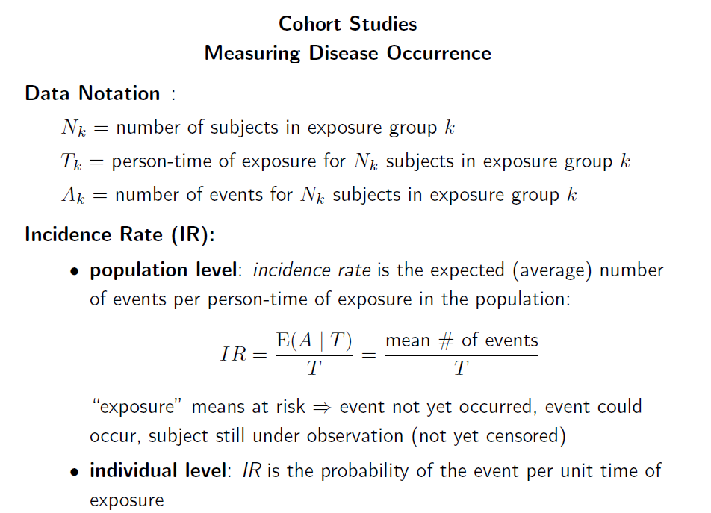

Slide 15
Descriptive analysis (grouped data)
. tabstat N_person LungCa NasalCa Deaths PY, by(EXP) s(sum)
Summary statistics: sum
by categories of: EXP (exposure category)
EXP | N_person LungCa NasalCa Deaths PY
---------+--------------------------------------------------
0.0 | 992 42 10 242 7738.755
0.5-4.0 | 668 50 17 205 4905.054
4.5-8.0 | 272 27 12 97 1716.924
8.5-12.0 | 102 12 10 40 601.1505
12.5+ | 48 6 7 19 268.896
---------+--------------------------------------------------
Total | 2082 137 56 603 15230.78
------------------------------------------------------------
K N_{k} A_{k} T_{k}

Slide 16
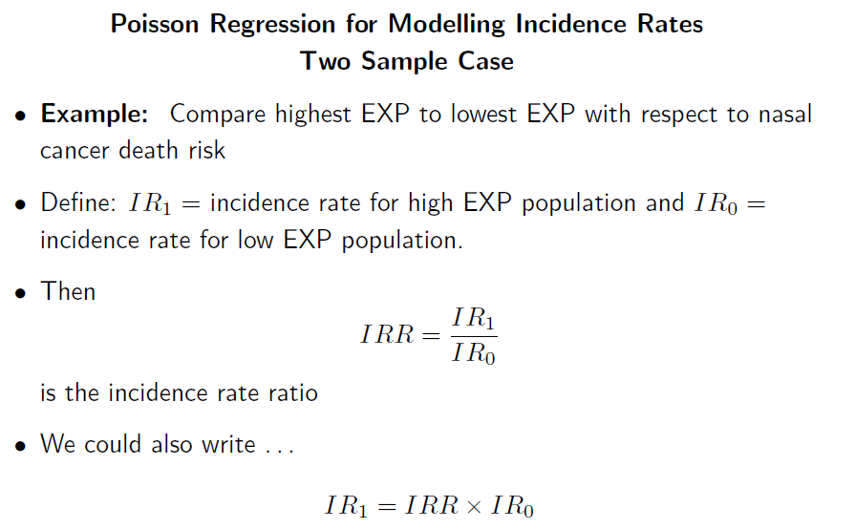

Slide 17
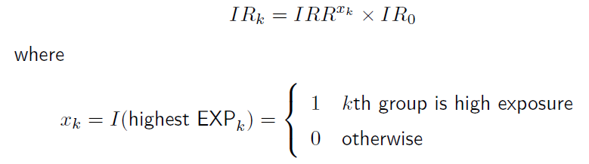
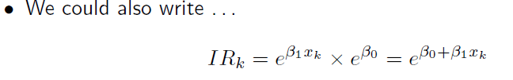
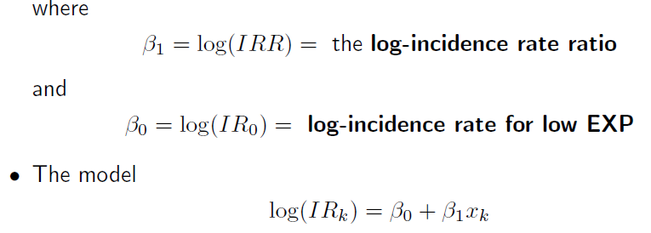

Slide 20
Poisson regression: nasal cancer and two level exposure
. gen expmax = 0 if EXP==1
(177 missing values generated)
. replace expmax = 1 if EXP==5
(18 real changes made)
. poisson NasalCa expmax, exposure(PY) nolog
Poisson regression Number of obs = 83
LR chi2(1) = 25.16
Prob > chi2 = 0.0000
Log likelihood = -54.021808 Pseudo R2 = 0.1889
------------------------------------------------------------------------------
NasalCa | Coef. Std. Err. z P>|z| [95% Conf. Interval]
-------------+----------------------------------------------------------------
expmax | 3.002996 .4928054 6.09 0.000 2.037116 3.968877
_cons | -6.651411 .3162278 -21.03 0.000 -7.271206 -6.031616
ln(PY) | 1 (exposure)
------------------------------------------------------------------------------
What is the sample size?

Slide 21
Poisson regression: nasal cancer and two level exposure
. poisson, irr
Poisson regression Number of obs = 83
LR chi2(1) = 25.16
Prob > chi2 = 0.0000
Log likelihood = -54.021808 Pseudo R2 = 0.1889
------------------------------------------------------------------------------
NasalCa | IRR Std. Err. z P>|z| [95% Conf. Interval]
-------------+----------------------------------------------------------------
expmax | 20.14581 9.927965 6.09 0.000 7.668459 52.92508
_cons | .0012922 .0004086 -21.03 0.000 .0006953 .0024016
ln(PY) | 1 (exposure)
------------------------------------------------------------------------------
.
?
Notes:
Beta 1: Log incidence ratio of nasal cancer mortality of the high exposure group compared to the lowest exposure group

Slide 22
Incidence rate of nasal cancer and two level exposure
. ir NasalCa expmax PY
| expmax |
| Exposed Unexposed | Total
-----------------+------------------------+------------
Nasal cancer dea | 7 10 | 17
Person years | 268.896 7738.755 | 8007.651
-----------------+------------------------+------------
| |
Incidence rate | .0260324 .0012922 | .002123
| |
| Point estimate | [95% Conf. Interval]
|------------------------+------------------------
Inc. rate diff. | .0247402 | .0054389 .0440415
Inc. rate ratio | 20.14581 | 6.508444 58.63099 (exact)
Attr. frac. ex. | .9503619 | .8463535 .9829442 (exact)
Attr. frac. pop | .3913255 |
+-------------------------------------------------
(midp) Pr(k>=7) = 0.0000 (exact)
(midp) 2*Pr(k>=7) = 0.0000 (exact)
Assume the occurrence of nasal cancer follows a Poisson distribution

Slide 23
Sample size from the group dataset
. tabstat N_person NasalCa PY, by(expmax) s(n sum)
Summary statistics: N, sum
by categories of: expmax
expmax | N_person NasalCa PY
---------+------------------------------
0 | 65 65 65
| 992 10 7738.755
---------+------------------------------
1 | 18 18 18
| 48 7 268.896
---------+------------------------------
Total | 83 83 83
| 1040 17 8007.651
----------------------------------------

Slide 25
. poisson NasalCa i.YFE i.EXP , exposure(PY) nolog
Poisson regression Number of obs = 242
LR chi2(7) = 62.32
Prob > chi2 = 0.0000
Log likelihood = -146.91435 Pseudo R2 = 0.1750
------------------------------------------------------------------------------
NasalCa | Coef. Std. Err. z P>|z| [95% Conf. Interval]
-------------+----------------------------------------------------------------
YFE |
2 | .7662945 .3701047 2.07 0.038 .0409026 1.491686
3 | .5244684 .5013795 1.05 0.296 -.4582173 1.507154
4 | -.4813688 .512387 -0.94 0.347 -1.485629 .5228913
|
EXP |
2 | .8527949 .4024174 2.12 0.034 .0640714 1.641518
3 | 1.209269 .4660264 2.59 0.009 .2958739 2.122664
4 | 2.115508 .5062347 4.18 0.000 1.123306 3.10771
5 | 2.64968 .5574622 4.75 0.000 1.557074 3.742286
|
_cons | -6.630379 .4930839 -13.45 0.000 -7.596806 -5.663952
ln(PY) | 1 (exposure)
------------------------------------------------------------------------------

Slide 26
. poisson NasalCa i.YFE i.EXP , exposure(PY) nolog irr
Poisson regression Number of obs = 242
LR chi2(7) = 62.32
Prob > chi2 = 0.0000
Log likelihood = -146.91435 Pseudo R2 = 0.1750
------------------------------------------------------------------------------
NasalCa | IRR Std. Err. z P>|z| [95% Conf. Interval]
-------------+----------------------------------------------------------------
YFE |
2 | 2.151778 .7963831 2.07 0.038 1.041751 4.444584
3 | 1.68956 .8471109 1.05 0.296 .63241 4.513866
4 | .617937 .3166229 -0.94 0.347 .2263599 1.686898
|
EXP |
2 | 2.346195 .9441496 2.12 0.034 1.066168 5.163003
3 | 3.351033 1.56167 2.59 0.009 1.344301 8.353359
4 | 8.293798 4.198608 4.18 0.000 3.075004 22.36975
5 | 14.14951 7.887819 4.75 0.000 4.744919 42.19434
|
_cons | .0013197 .0006507 -13.45 0.000 .0005021 .0034688
ln(PY) | 1 (exposure)
------------------------------------------------------------------------------
est store A

Slide 28
. quietly poisson NasalCa i.YFE, exposure(PY) nolog irr
. est store B
. lrtest A B, stats
Likelihood-ratio test LR chi2(4) = 27.26
(Assumption: B nested in A) Prob > chi2 = 0.0000
-----------------------------------------------------------------------------
Model | Obs ll(null) ll(model) df AIC BIC
-------------+---------------------------------------------------------------
B | 242 -178.0753 -160.5437 4 329.0874 343.0431
A | 242 -178.0753 -146.9143 8 309.8287 337.7402
-----------------------------------------------------------------------------
Note: N=Obs used in calculating BIC; see [R] BIC note
Notes:
EXP is necessary

Slide 29
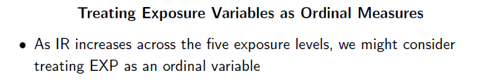
. ** trend test:
. poisson NasalCa i.YFE EXP , exposure(PY) nolog irr
Poisson regression Number of obs = 242
LR chi2(4) = 61.58
Prob > chi2 = 0.0000
Log likelihood = -147.28696 Pseudo R2 = 0.1729
------------------------------------------------------------------------------
NasalCa | IRR Std. Err. z P>|z| [95% Conf. Interval]
-------------+----------------------------------------------------------------
YFE |
2 | 2.142474 .7855349 2.08 0.038 1.044296 4.395491
3 | 1.713785 .8542752 1.08 0.280 .6451427 4.552576
4 | .6420139 .3269913 -0.87 0.384 .2365971 1.742126
|
EXP | 1.92699 .2452079 5.15 0.000 1.501636 2.472829
_cons | .0007225 .0004014 -13.02 0.000 .0002432 .0021466
ln(PY) | 1 (exposure)
------------------------------------------------------------------------------
. est store C

Slide 30
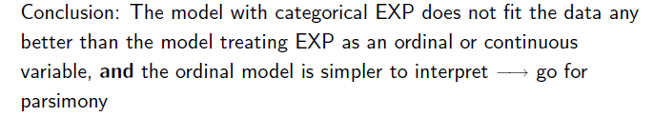
. lrtest A C, stats
Likelihood-ratio test LR chi2(3) = 0.75
(Assumption: C nested in A) Prob > chi2 = 0.8625
-----------------------------------------------------------------------------
Model | Obs ll(null) ll(model) df AIC BIC
-------------+---------------------------------------------------------------
C | 242 -178.0753 -147.287 5 304.5739 322.0186
A | 242 -178.0753 -146.9143 8 309.8287 337.7402
-----------------------------------------------------------------------------
Note: N=Obs used in calculating BIC; see [R] BIC note

